Slide 2
If you want to go to a new place, how do you find your way?
What does GPS mean?
Do you know how GPS works?

Slide 3
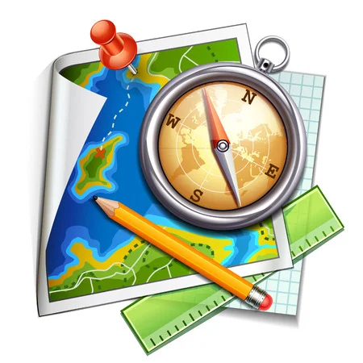
UNIT 6
SURVIVAL
LESSON 8: CLIL
TECHNOLOGY

Slide 4
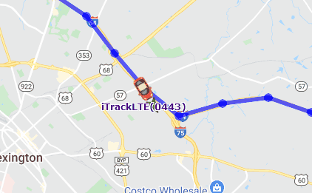
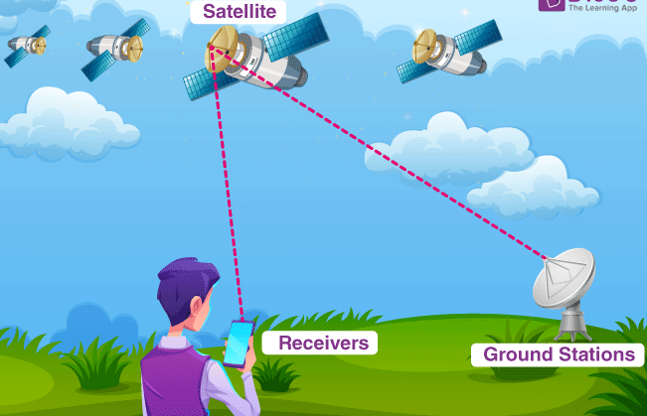
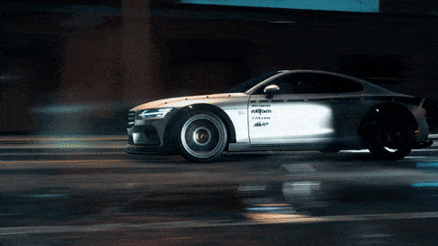
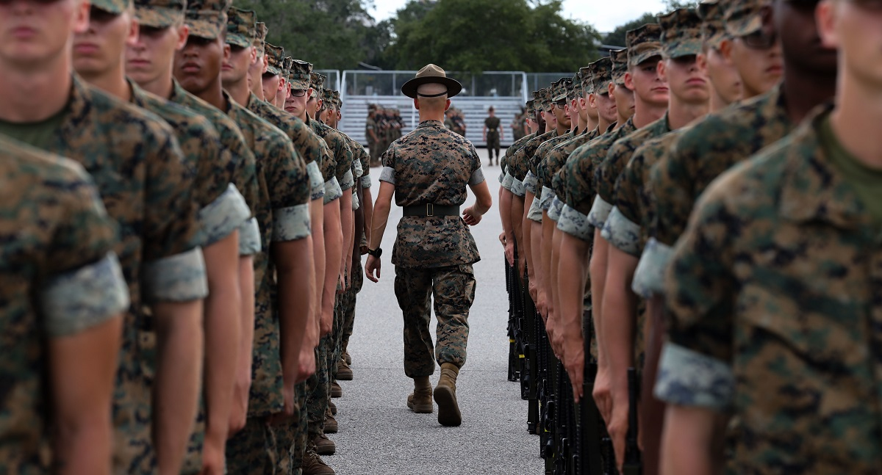
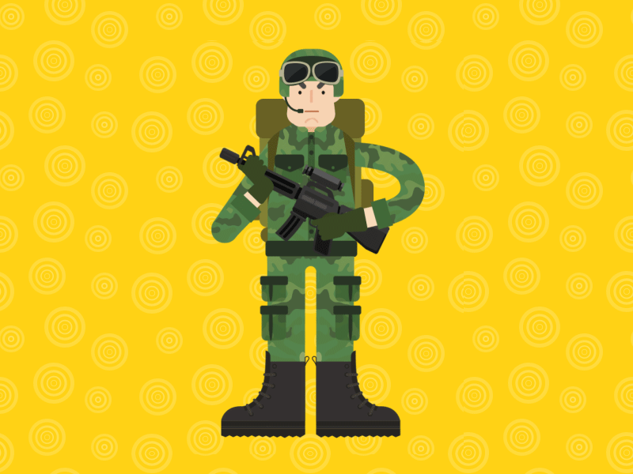
New words
Application (n)
Receiver (n)
Satellite (n)
Speed (n)
Track (v)
Military (a)
Soldier (n)

Slide 5
Activity 1: Check the meaning of the words in the box. Then read and complete the text with the words from the box. Listen and check. applications receiver speed track
track
receiver
speed
applications

Slide 6
Activity 2: Read the text again and match 1–6 with a–f.
1 e
2 a
3 f
4 b
5 d
6 c

Slide 7
Activity 3: Read the text again and answer the questions
Answer:
1 In the 1970s
2 To find out exactly their locations, and track their movements
3 By tracking your position over time
4 A smartphone and GPS, a compass, torch and map

Slide 8
Activity 4:

Slide 9
- Learn by heart all the new words. - - Prepare Progress Review Ex 1,2,3,4

